Slide 1
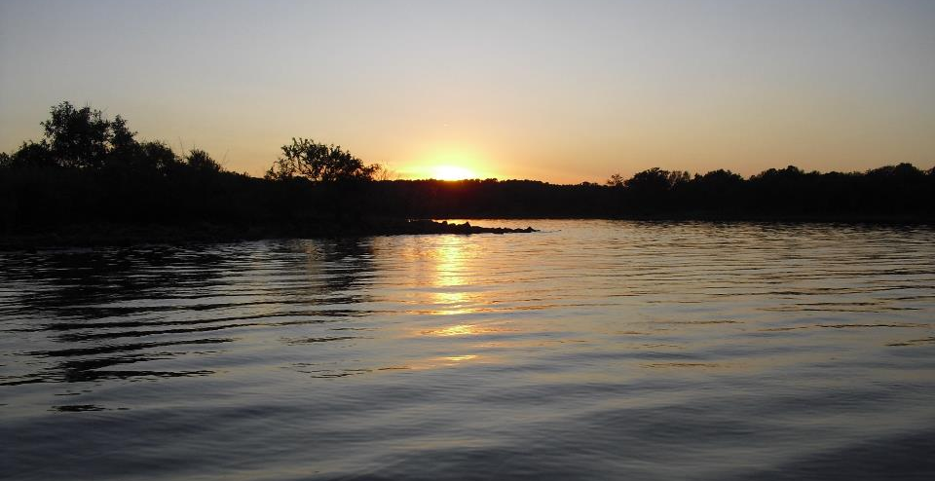
Field Forms: Types, Formats, Data, Recordkeeping
GCSA Workshop
OKR04 MCM-3 and Part IV Sampling and Field Methods
Presented by INCOG
Nienhuis Park
May 18, 2022

Slide 2
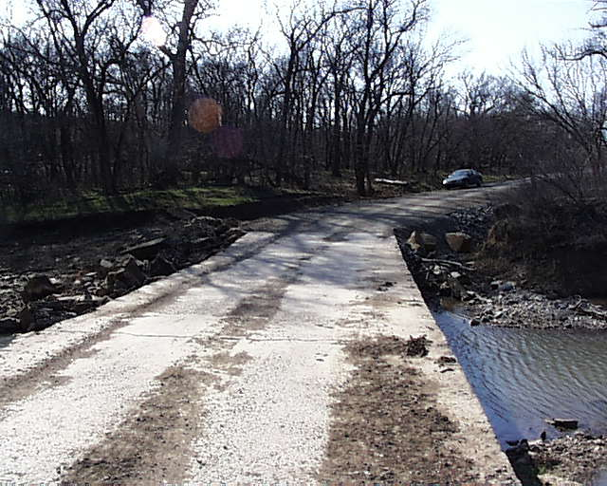
Field Forms: Purpose of Field Data
Document water quality baselines.
Monitoring POC sources in DWFS, TMDLs and IDDE.
Enhanced data quality for enforcement actions.
Partner with other MS4s in regional sampling.
Provide data to support MCM site inspections.
Investigate reported pollution problems & citizen complaints.
Respond to concerns from DEQ and MS4 management.

Slide 3

Field Forms: Data Needs (DQOs)
For each Field Form: Why is the data being collected?
Who will use the data; how will it be used?
  Stormwater staff only? OKR04 compliance only?
  Posted online for public viewing?
  Shared with agencies, organizations? Purpose?
How is data to be processed?
  Statistical analysis? Narrative summary?
  Converted into report tables? Graphs?
Form Usefulness:
  Form is easy to read, use and understand.
  No unneeded data, no repetitions, use boilerplate.

Slide 4

Field Forms: Types
OKR04 does not require specific types of data to be collected when performing inspections and monitoring.
OKR04 does not require data recording methods or forms to be used.
OKR04 does not specify how field data should be kept (paper files, spreadsheets, MS4-software, GIS, etc.).
This flexibility leaves decisions up to local stormwater program managers.
Example of a bad field form!
This Photo by Unknown Author is licensed under CC BY-SA-NC

Slide 5
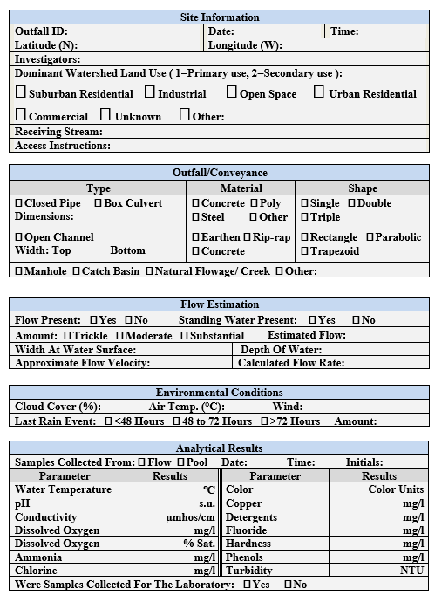
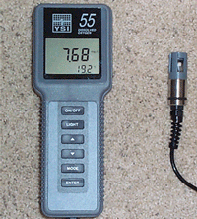
Field Forms: Paper vs. Electronic
Paper forms: easiest to set up and use in the field.
Paper forms: require entering data twice - in the field and in the office (e.g., spreadsheets, reports).
Electronic devices: for field data capture:
  GPS units programmed to enter data.
  Measurement instruments programmed to record data.
  Field laptops and tablets with software for data entry.
  GIS software and devices for recording data.
  Devices can download to computers or use telemetry.
  Downside: expensive, big learning curve, inflexible.

Slide 6

Field Forms: Create and Obtain
PDF, word processing and other software can generate forms, many with auto-fill direct to spreadsheets.
Internet searches for existing files of forms for download and local customization.
Oklahoma agencies (ODEQ, INCOG, OWRB, OCC, etc.).
Create your own from scratch (Word, Excel, PDF, etc.).
MS4 Software (e.g., CBI, ASIST, etc.) generates forms.
Borrow ideas from other MS4s.
Guidance documents from EPA and other organizations.
No endorsement of products is intended.

Slide 7
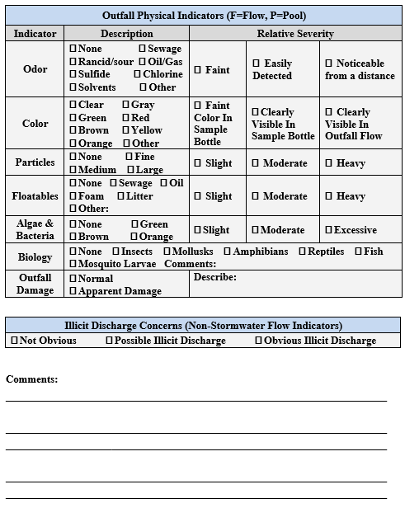
Field Forms: Formats and Usefulness
IMPORTANT: Ease of Use:
  Fieldwork is no place to struggle with a difficult form.
  Common problems: too small font, too crowded text, not enough space for writing entries, insufficient instructions.
IMPORTANT: Thoroughness:
  Know in advance all data you will need.
  Forms should be organized into groups.
  Avoid having to write in margins.
  Get feedback from field staff and data users.

Slide 8

Field Forms: Unavoidable Problems
Department budget cuts force software changes.
Computer file loss or corruption (e.g., malware attack).
Permit changes trigger new requirements.
New programs (e.g., new TMDLs, 303(d), BMPs, etc.)
New management’s “I have a better idea”.
Physical loss of files (e.g., fire, theft, flood, etc.).
Former stormwater manager leaves no clue as to where any files are or what was done in the past.

Slide 9
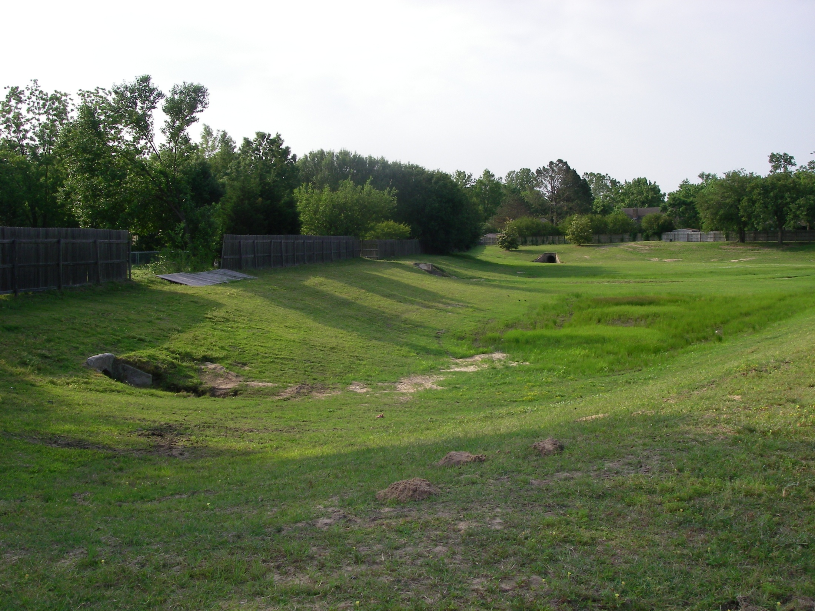
Field Notes Must Be Detailed
Clearly state which basin inlet was inspected.

Slide 10
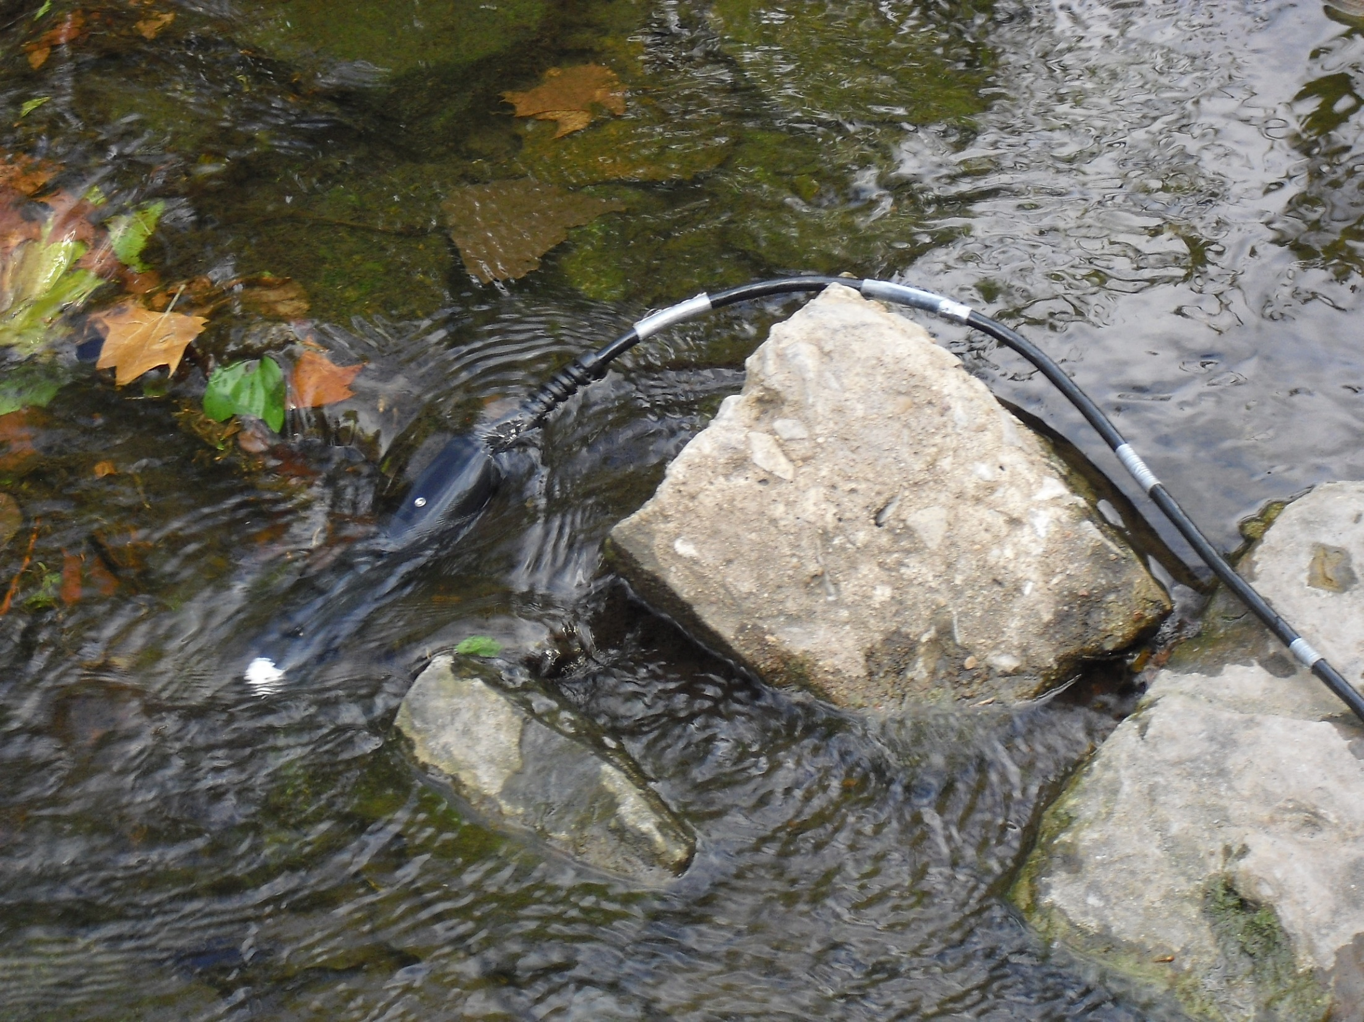
Field Forms and Notes
Use forms for consistency, completeness, error control, training.
Location info (address, lat-long, site id. number).
Brief site physical description (culvert, creek).
Date & time and field crew names.
Visual observations:
  General site conditions (culverts, stream bed and banks, vegetation)
  Adjacent land uses (residential, industrial, agriculture, woodland)
  Specific indicators of pollution and ID sources (color, odor, containers, etc.)
Estimated or measured velocity and xSect area.
Envir. conditions (weather, sunlight, rainfall)
Field kit test and measurement results.

Slide 11
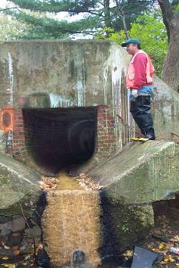
Field Observations
Field notes of any observations of interest.
What are the origins of unusual flow?
What are visual and chemical aspects of the flow?
What is the volume (e.g., gal./min.) of discharge flow?
Colors, odors, soil stains, dead vegetation, etc.
Use “check-box” field forms.
Try not to change data types on forms too much, it causes headaches with analysis.

Slide 12
Field Form: Visual Observations
Create your own list and form contents
Water velocity (estimated)
Width and depth of water
Color of water
Color of stream bank stains
Odors of the water
Odors within the vicinity
Algae growth
Vegetation (dead or dying)
Trash and debris
Dead animals
Lawn clippings (yard materials)
Barrels and containers
Oily sheen on water
Silt & sediment buildup
Opacity of water
Foam or suds
Chemical residues on banks
Land uses in vicinity
Buildings in vicinity
Interviews with neighbors

Slide 13
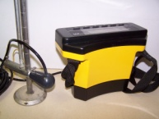
Determining Flow
Flows in streams and pipes are important in data analysis.
Measurements are best, but visual estimates also help.
Field forms should have spaces for flow entries.
Measure or estimate width and depth (xSect area in ft²).
Measure time of floating of an object (velocity in ft/s)
Velocity times xSect area = Discharge (cfs).

Slide 14
Weather Conditions on Field Forms
“ENVIRONMENTAL CONDITIONS DURING SAMPLING”
TIME | CLOUD COVER | AIR TEMP (F) | WIND Sp & Dir | OTHER CONDITIONS
07:00
09:00
12:00
15:00

Slide 15
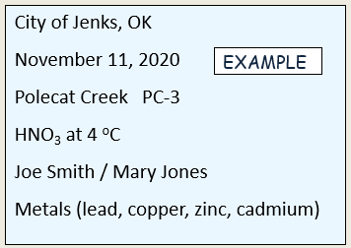
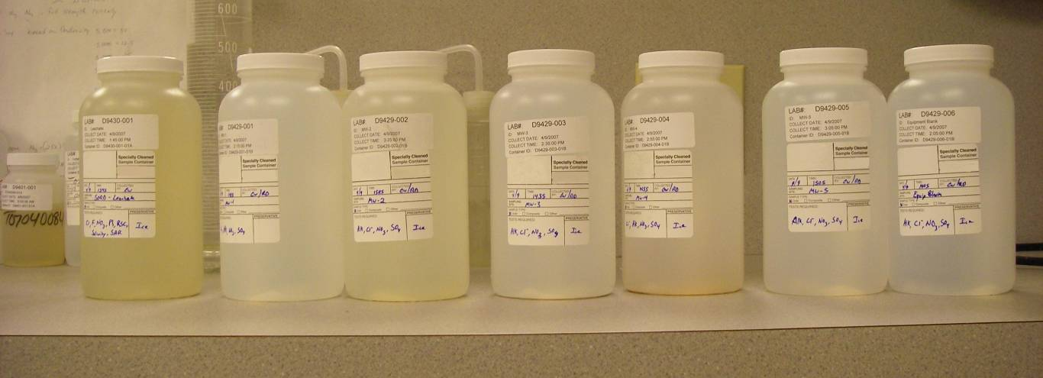
Labels for Sample Containers
Get lab approval of label information.
Use waterproof labels and ink; suggest
  City Name
  Sample date and time
  Site name and code number
  Preservative
  Names of field crew members
  Parameter(s) for analysis

Slide 16
Chain of Custody Form
Collector: |  |  |  | Date Sampled:
Address: FAX:
Project: |  |  |  | Project #:
Analyses Requested: (Arranged by present contract).
LAB SAMPLE NUMBER | CITY SAMPLE NUMBER | CONTAINER P / G | PRESERVATIVE | FIELD INFORMATION
1
2
3
4
5
6
7
8
Relinquished By: Date / Time: |  |  | Accepted By: Date / Time:
Relinquished By: Date / Time: |  |  | Accepted By: Date / Time:
Relinquished By: Date / Time: |  |  | Accepted By: Date / Time:
Relinquished By: Date / Time: |  |  | Accepted By: Date / Time:

Slide 17
Common Units of Measure
mg/L milligrams per liter (approximately parts per million)
ug/L micrograms per liter (approximately parts per billion)
lbs/d pounds per day (a measure of pollutant loadings).
cfs cubic feet per second (a measure of “discharge”)
fps feet per second (a measure of velocity of flowing water)
NTU Nephelometric Turbidity Unit (turbidity unit)
uS/cm microsiemens per centimeter (conductivity unit)
ºC centigrade or Celsius (temperature scale used most)

Slide 18

Are SWMP DWFS Procedures Enough?
“SOPs” are not mentioned in OKR04.
Can add DWFS Procedures to the SWMP.
Too many procedures in SWMP can overwhelm document.
OKR04 has no guidance on performing DWFS.
DWFS methods left to each MS4.
Consult outside sources: DEQ, INCOG, manuals, internet, etc.

Slide 19

Field Forms: Recordkeeping
Keep track of ALL data collected for OKR04 compliance, including maps, etc.
Use a Transition Plan.
Be organized, whether you use paper only, computer filing system, or a combination.
Don’t be too complicated, avoid depths of subcategories.
Too simple is just as bad; find a middle ground.
Use a records tracking system.
Communicate with other departments.

Slide 20
Field Form Data Recordkeeping
Simple: Procedures easy to read and update.
Generalized: Flexible, avoid rigid overwhelming detail.
Use visuals: Diagrams, tables, bullet lists, pictures.
No data redundancy: be concise, organized.
Procedure References: Title, revision # and date, contact person.
Rely on Computers: Helps with data analysis and data handling.
Annual Reports: Types of AR data dictate how you process DWFS data.
Local Use: Data should be useable for MS4’s program.

Slide 21



Questions ?
Vernon Seaman
Manager, Envir. and Energy Planning
INCOG
Two West 2nd Street, Ste 800
Tulsa, OK 74103
(918) 579-9451
vseaman@incog.org

